Slide 1
Keras2c: A library for converting Keras neural networks to real-time compatible C
Rory Conlin ª, Keith Erickson ^{b}, Joseph Abbate ^{c}, Egemen Kolemen ª ^{b}
ª Department of Mechanical and Aerospace Engineering, Princeton University, Princeton NJ 08544, USA
^{b} Princeton Plasma Physics Laboratory, Princeton NJ 08544, USA
^{c} Department of Astrophysical Sciences at Princeton University, Princeton NJ 08544, USA

Slide 2
Keras and existing solutions
Keras is an open-source deep learning framework for building and training neural networks.
What’s the problem? Speed, integration, latency and data-controlling
Existing solutions: TorchScript, Frugally Deep, mlpack, FANN, Tensor Flow Light

Slide 3
Start problems and tasks for research
deploy Keras models on low-resource devices with real-time constraints
provide a solution that allows developers to compile Keras models into real-time compatible C code for efficient and optimized models

Slide 4
The way of research
Weight & Parameter Extraction
Graph Parsing
C Backend

Slide 5
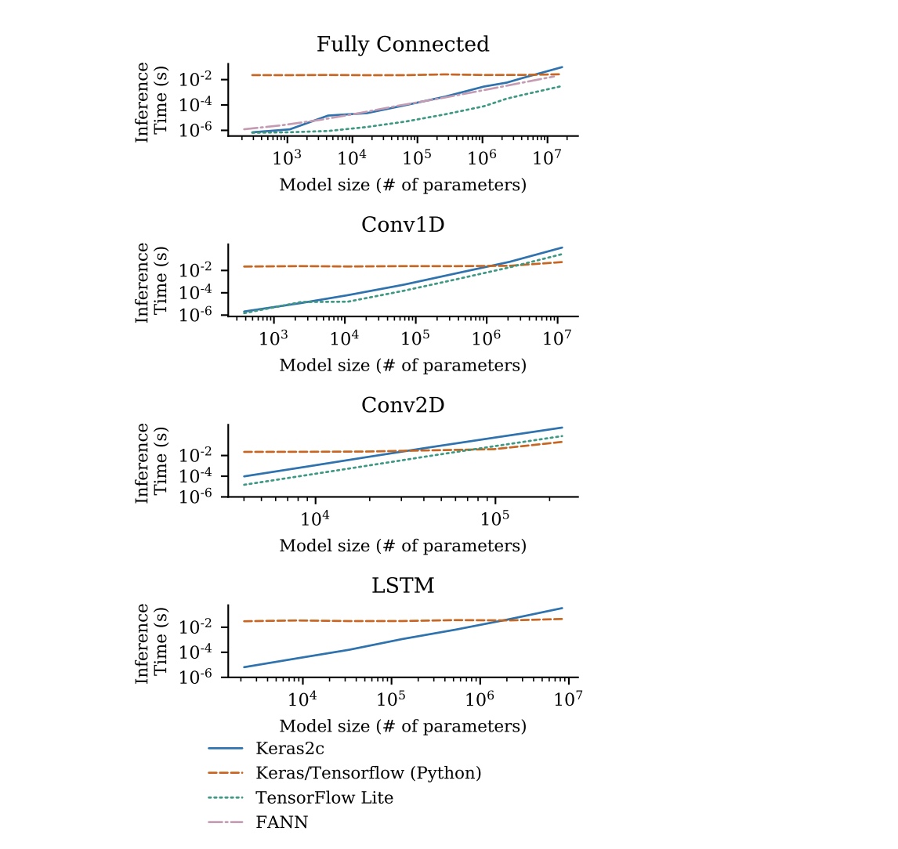
Benchmarks

Slide 6
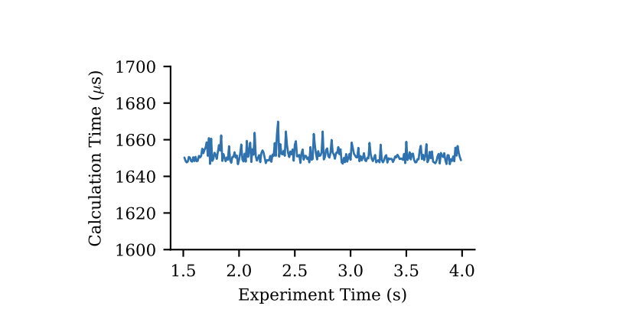
Real-time application

Slide 7
Results
Convert Keras to C
Easy deployment
No complicated dependencies
Human-readable code
Competitive with TensorFlow
Low-latency, deterministic
Used in plasma control system
Future improvements planned.

